Slide 1
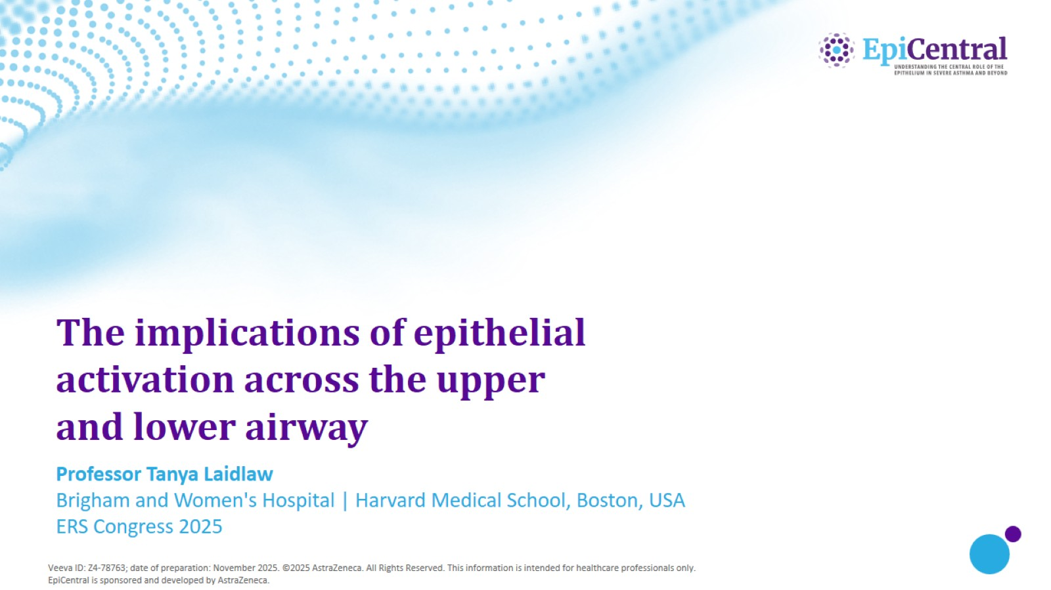
The implications of epithelial activation across the upper and lower airway

Slide 2
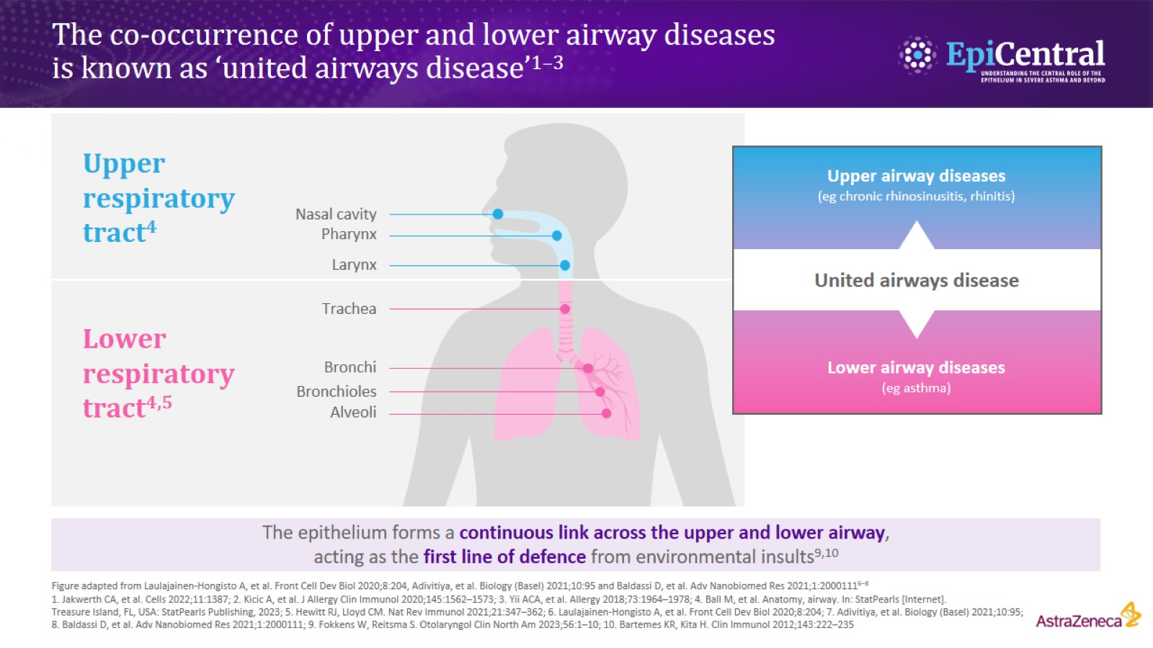
The co-occurrence of upper and lower airway diseases is known as ‘united airways disease’^{1–3}

Slide 3
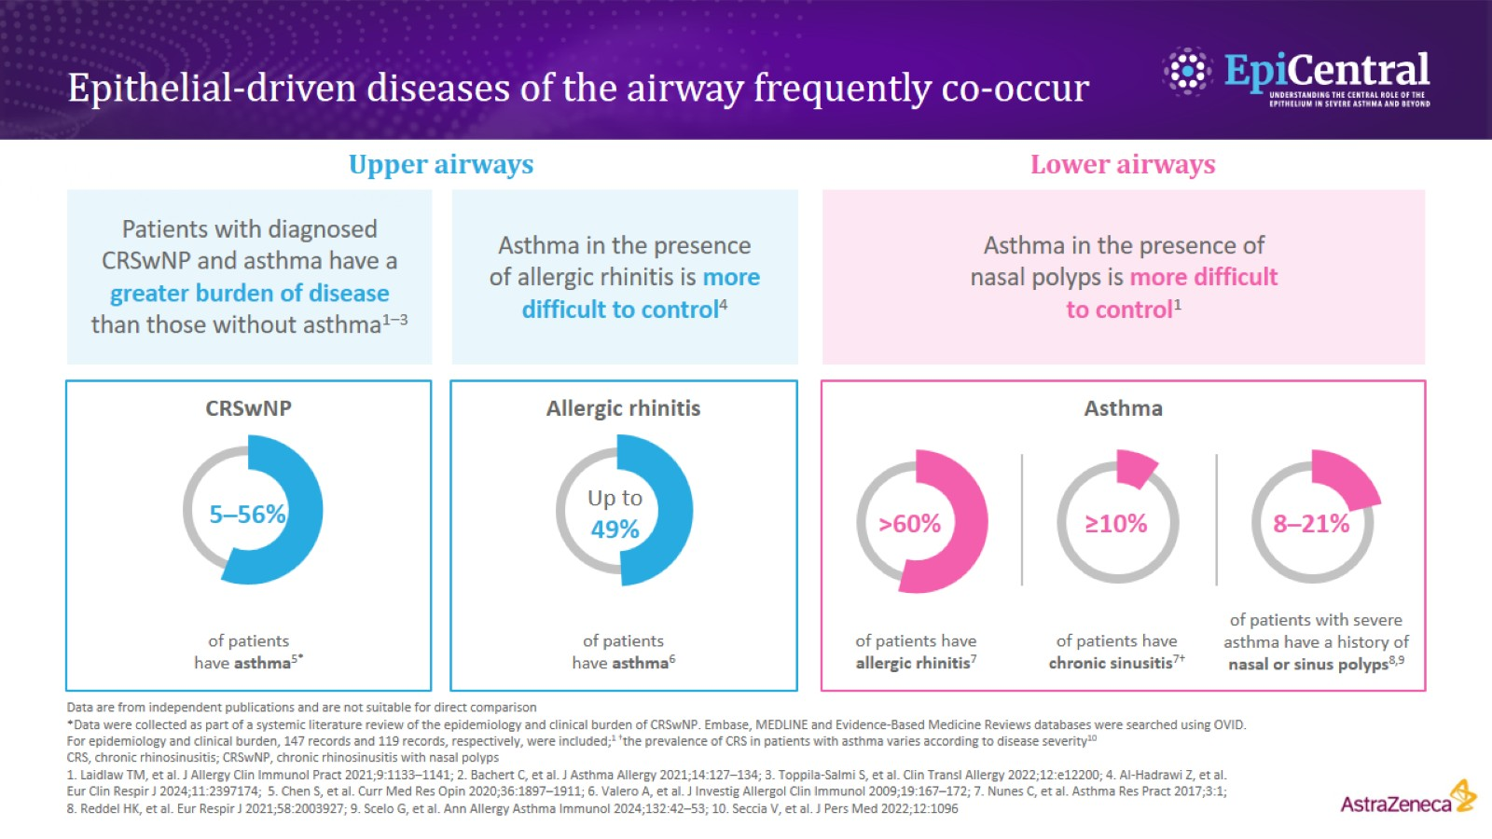
Epithelial-driven diseases of the airway frequently co-occur

Slide 4
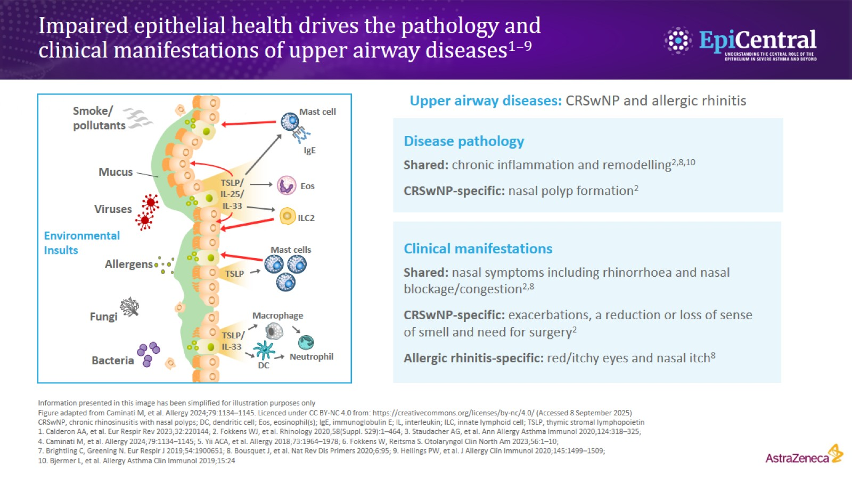
Impaired epithelial health drives the pathology and clinical manifestations of upper airway diseases^{1–9}

Slide 5
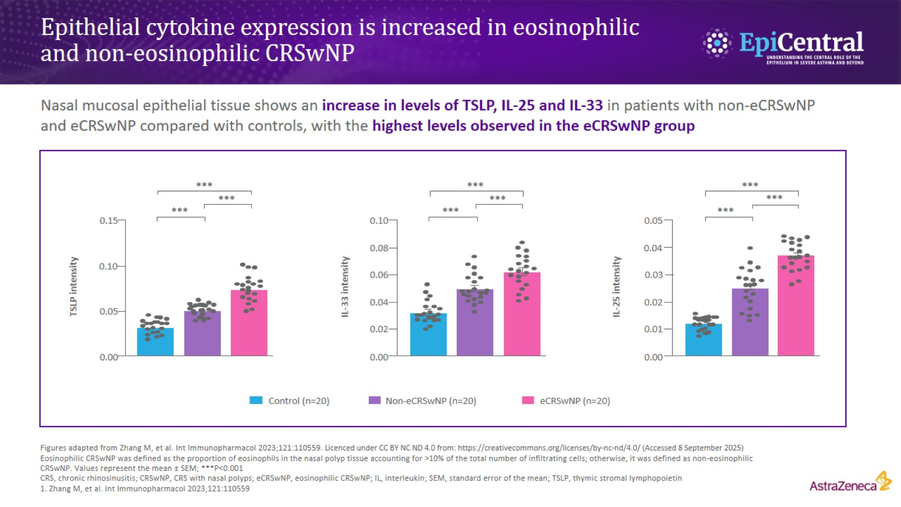
Epithelial cytokine expression is increased in eosinophilic and non‑eosinophilic CRSwNP

Slide 6
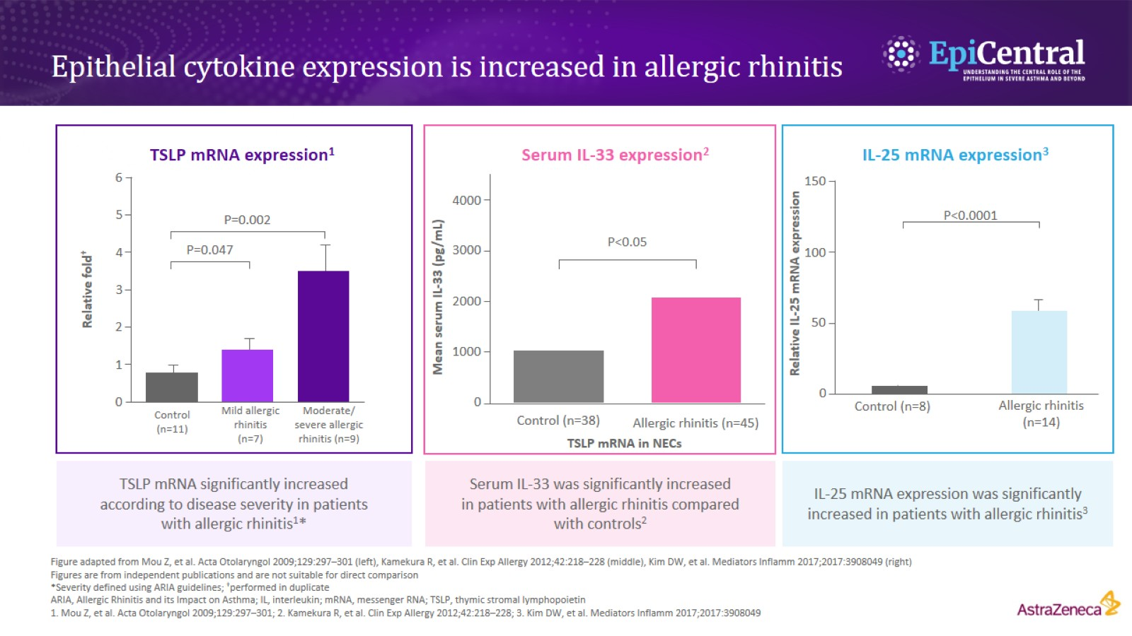
Epithelial cytokine expression is increased in allergic rhinitis

Slide 7
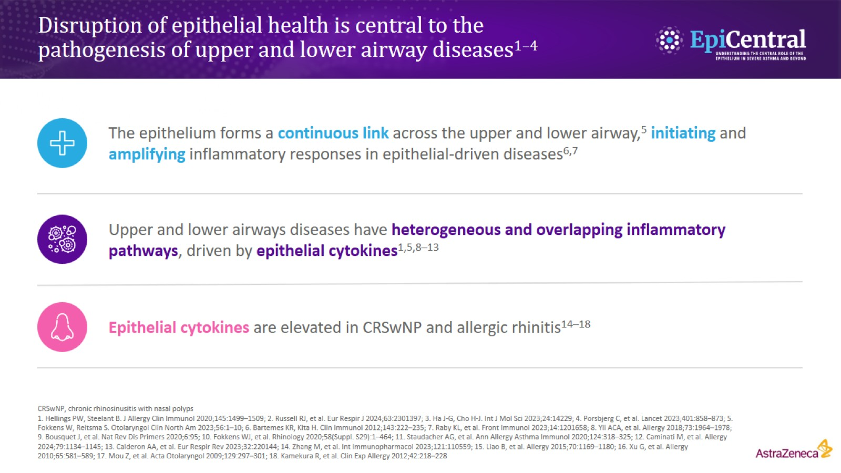
Disruption of epithelial health is central to the pathogenesis of upper and lower airway diseases^{1–4}

Slide 8
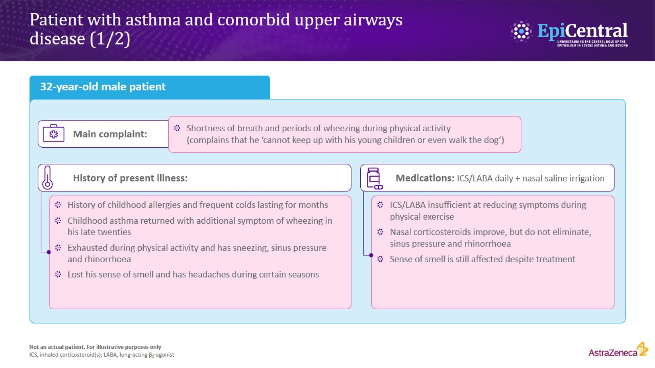
Patient with asthma and comorbid upper airways disease (1/2)

Slide 9
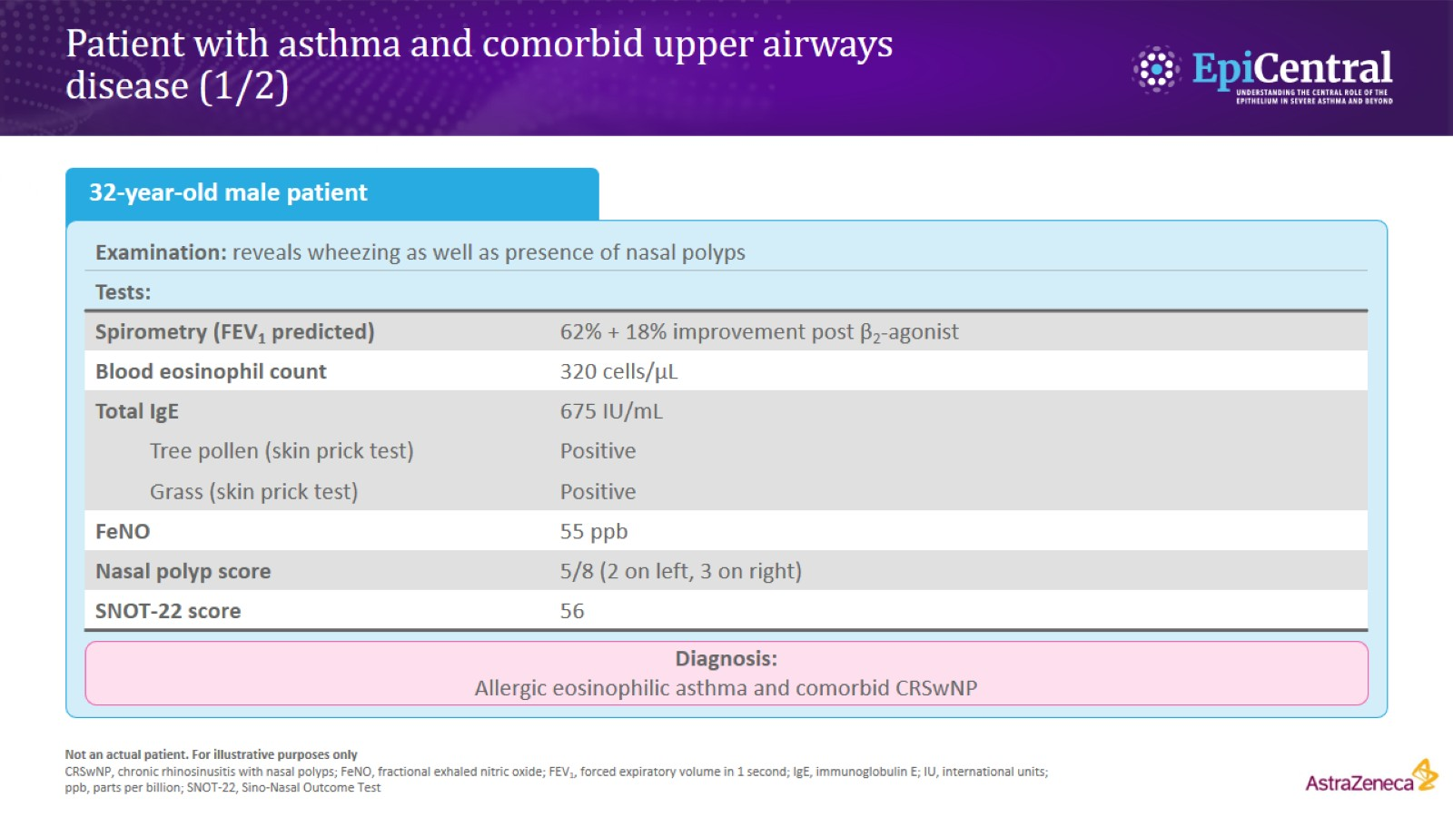
Patient with asthma and comorbid upper airways disease (1/2)

